Slide 1

Valley Water Collaborative
Final Management Zone Proposal (fmzp)
Public Comment - Community engagement

Slide 2

Meeting Goals
Get to know the Valley Water Collaborative (VWC) and how we can work with your community.
Understand what’s happening in the Central Valley regarding groundwater quality related to drinking water.
Learn about the Final Management Zone Proposal (FMZP) and how we can collaborate to ensure safe drinking water.
Find out where to access the FMZP and how to submit feedback.

Slide 3

VALLEY WATER COLLABORATIVE (VWC)
Why?
Domestic wells are not regulated/tested by any agency
Many small towns and rural homes use well water
Some wells contain nitrate
Nitrate above the drinking water standard is unsafe to drink
VWC works with communities to help
Who?
We are a non-profit organization formed in 2020 to improve quality of life in California’s Central Valley by ensuring access to safe, reliable drinking water and working collaboratively to protect and strengthen the groundwater that communities depend on.
Where?
We operate in seven groundwater basins (or management zones) in the Central Valley to implement the requirements of the Nitrate Control Program.
Success Looks Like:
Residents understand what’s in their drinking water through free well testing
Residents have access to safe drinking water when nitrate levels are too high
BOTTOM LINE We help residents learn more about their domestic well and offer replacement water if needed.

Slide 4
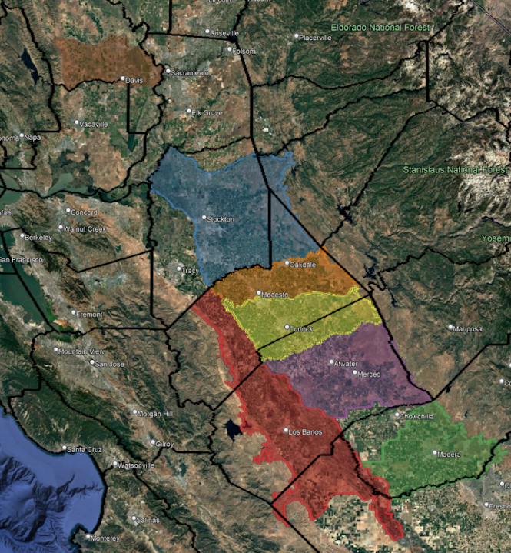
VWC Management Zones
Subbasin/County Map
Yolo Subbasin: Yolo County
Eastern San Joaquin Subbasin: San Joaquin and Stanislaus Counties
Modesto Subbasin: Stanislaus County
Turlock Subbasin: Stanislaus and Merced Counties
Delta-Mendota Subbasin: Stanislaus, Merced and Fresno Counties
Merced Subbasin: Merced County
Madera Subbasin: Madera County
www.valleywaterc.org

Slide 5
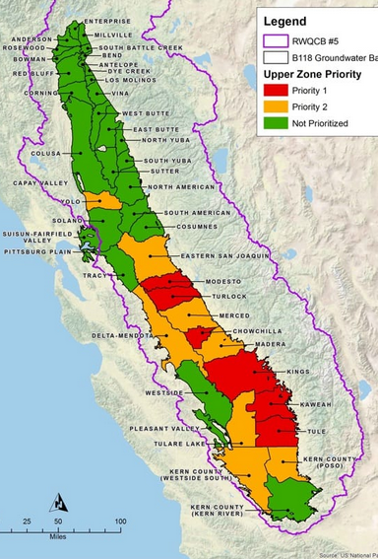
WHAT IS THE NITRATE CONTROL PROGRAM?
The Nitrate Control Program is a regulation that will help resolve problems with nitrate in the Central Valley. There are three goals of the Nitrate Control Program:
Provide safe drinking water supplies
Reduce nitrate impacts to water supplies
Restore groundwater quality, where reasonable, feasible, and practicable.
NITRATE CONTROL PROGRAM FOCUS AREAS
NITRATE REDUCTION PROGRAM
FREE WELL TESTING & REPLACEMENT DRINKING WATER
LONG-TERM DRINKING WATER SOLUTIONS
More information about the Nitrate Control Program: www.cvsalinity.org/nitrate-control-program.html

Slide 6
What is the FMZP?

Slide 7
FINAL MANAGEMENT ZONE PROPOSAL (FMZP)
The FMZP is a proposal submitted to the Central Valley Water Board. It addresses how VWC plans to implement well testing and replacement drinking water.
The FMZP Contains Information about:
-Where nitrate contamination is a concern
-How VWC implements the program
- How communities can participate
This document sets the foundation for future solutions.

Slide 8
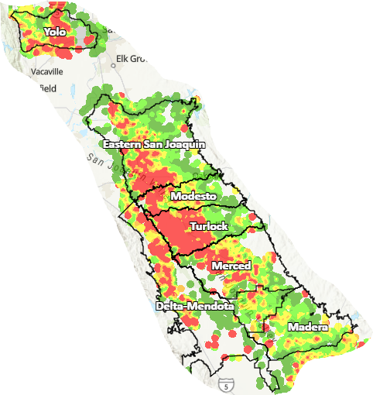
FMZP TABLE OF CONTENTS
Water quality and general descriptive information about each of the 5 Management Zones
Key Elements of Table of Contents
Background and Purpose Characterization of Proposed Management Zones Initial Assessment of Groundwater Conditions Management Zone Participants Current Nitrate Treatment and Control Efforts or Management Practices (of participants) Early Action Plan Development
Information about the permitted dischargers participating in each proposed Management Zone
Summary information about the Early Action Plan which is attached as an appendix

Slide 9
EARLY ACTION PLAN “Plan for Public Review”
Key Elements of Table of Contents
Executive Summary Resumen Ejecutivo 1. Background and Purpose 2. Community Outreach 3. Identification of Potentially Impacted Groundwater Users 4. Process to Identify Potentially Affected Areas 5. Community Outreach During EAP Implementation 6. Interim Replacement Water Program 6.1 Tailored Water Delivery Program 6.2 Centralized Water Delivery Program: Water Fill Stations 6.3 Residential Well Testing Program
Concise Summary of Program – How to Contact the VWC
Opportunities to Participate
Free Well Testing
How to Obtain Replacement Water

Slide 10
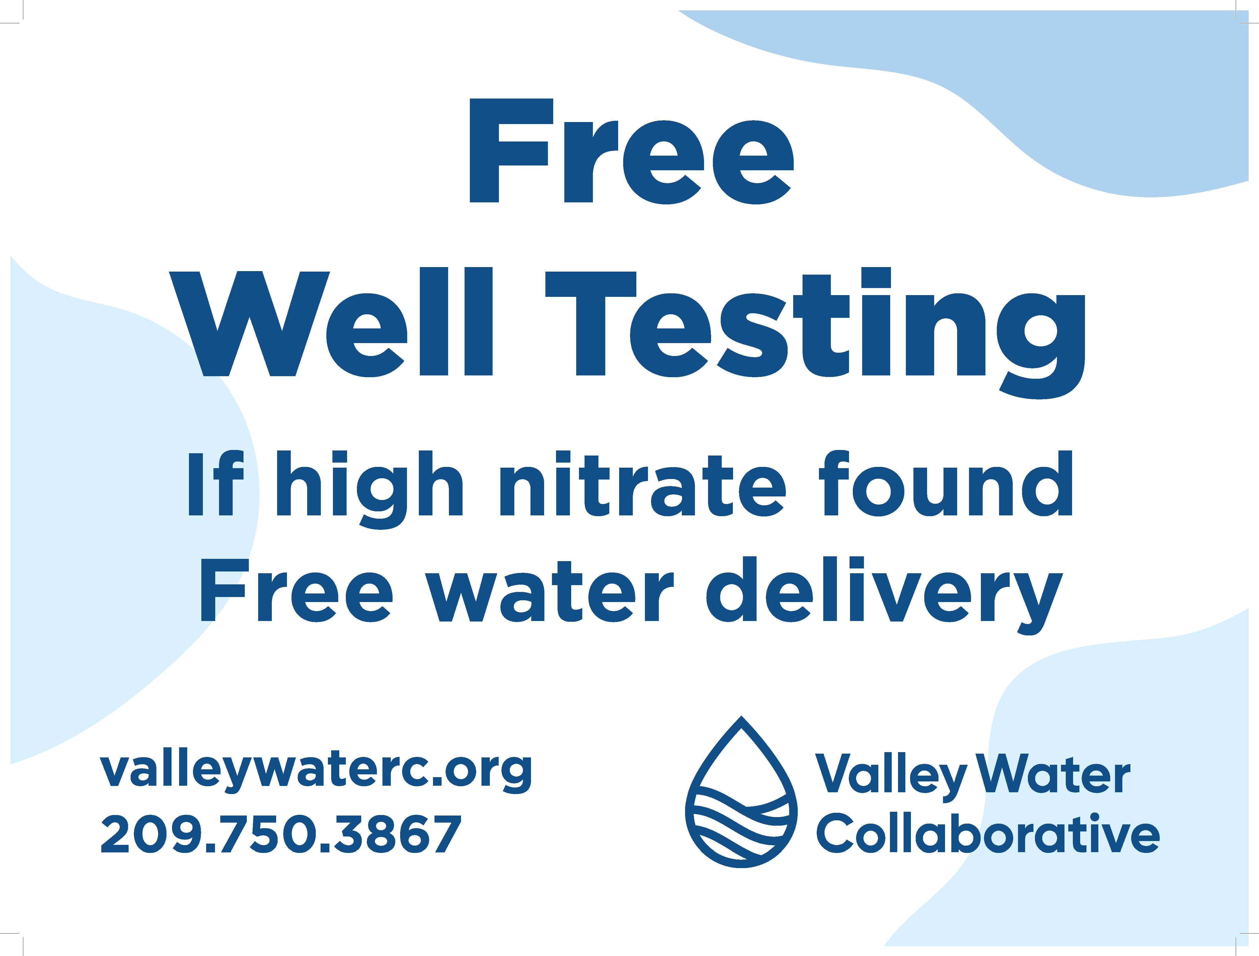
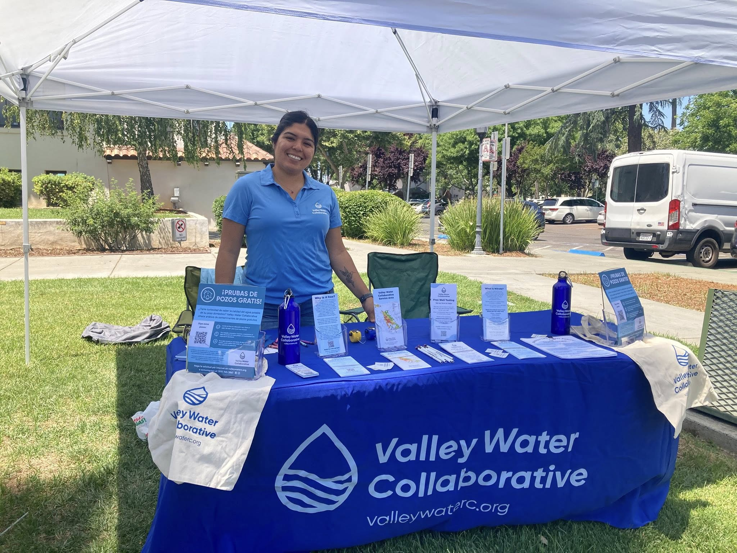
COMMUNITY ENGAGEMENT
Extensive outreach ensures residents know about drinking water support.
Tabling at public community events
Distributing flyers at local businesses
Regular postcard mailings
Partnering with community organizations and leaders
Connecting with schools
Media support through newspaper articles and TV
Social Media support and collaboration with partners

Slide 11

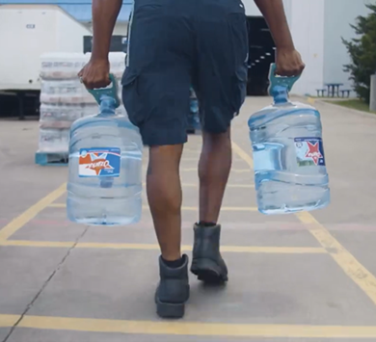
WELL TESTING & REPLACEMENT DRINKING WATER
OVERVIEW: Implement free domestic well testing and bottled water delivery until permanent solutions are implemented
Domestic Well Testing for residents that are in the Management Zone and have a domestic well
If well testing shows levels above the nitrate drinking water standard
Free Bottled Water Delivery is coordinated

Slide 12
CALL TO ACTION!
How to Share Your Comments
Read the
“Plan for Public Review”
Send comments by email
Ask questions TODAY!
Email: contact@valleywayterc.org
Website: www.valleywaterc.org
Comments can be short. One sentence is okay.
Your Input is Important
- Local voices matter - Better plans come from feedback
Good plans need community guidance
What Kind of Feedback Can You Share? - Is this clear? - What is missing? - What should we do better? You do not need to be a technical expert. Lived experience matters.

Slide 13

What Happens Next?
January 30th - Public comments are due to VWC
February 6th - Comments reviewed & considered
February 16th - FMZP submitted to the Central Valley Water Board
Central Valley Water Board reviews proposal
Central Valley Water Board opens a Public Comment period for review from any interested person, agency or organization
Once the FMZP is approved, work begins to draft the Management Zone Implementation Plan
Meanwhile….VWC continues to offer free well testing and access to safe drinking water throughout the process.

Slide 14
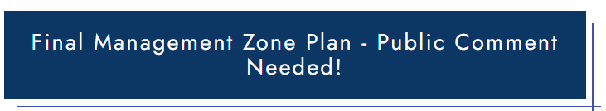
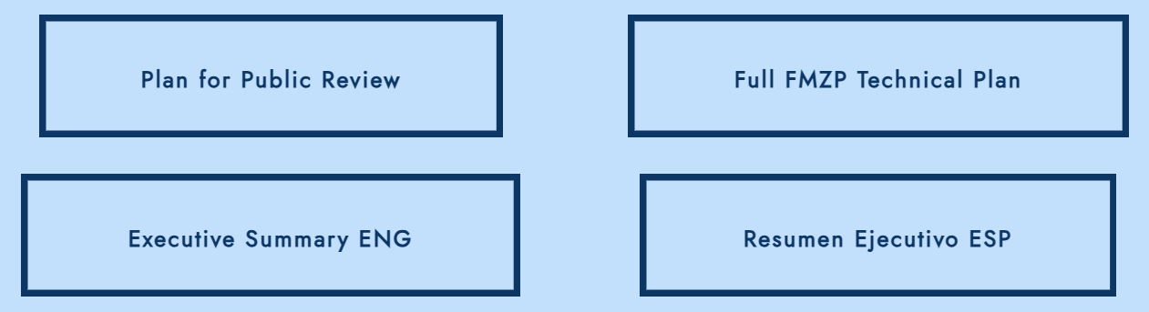
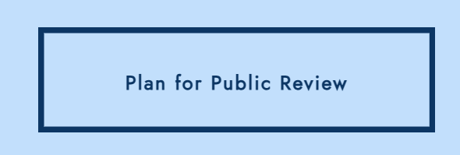
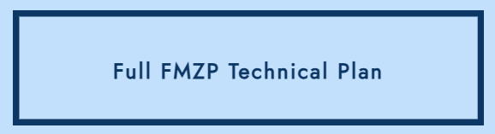
How to Find the Plan for Review
Visit our website www.valleywaterc.org
Click this button on our Home page
This takes you to the Act Now tab
Scroll past the well test application link and you will see four buttons.
You may review any document you want.
There are two major components to the FMZP.
The Plan for Public Review, is the Early Action Plan (EAP). This is important for residents and community members to review because it explains how VWC implements the free well testing and water delivery.
The Full FMZP Technical Plan, is the technical document with extensive details about how VWC will meet all of the Nitrate Control Program requirements.

Slide 15
This is going to be a long road. But please walk it together with us! We cannot make these decisions without YOU!

Slide 16

QUESTIONS / COMMENTS?

Slide 17

THANK YOU!
CONNECT WITH US & LEARN MORE!
Valley Water Collaborative www.valleywaterc.org
Nitrate Control Program https://www.cvsalinity.org/nitrate-program/
VWC Phone: 209-750-3867
VWC Email: contact@valleywaterc.org

